Slide 1
Fiscal Year 2014-15 Annual Report
Measure A Oversight Committee
February 23, 2016

Slide 2
Oversight Committee Roles and Responsibilities
Measure A half-cent sales tax passed in 2012
Required appointment of oversight committee-- two residents appointed in each Board district
Committee performs annual audit of revenues
Also reviews spending and performance
Submits annual report to Board of Supervisors

Slide 3
Oversight Committee Process
Met on December 3, 2015 to review audit of receipts and spending, performance report
Created Performance Measures subcommittee which met in January 2016
Staff incorporated performance measure recommendations in annual report
Approved annual report for submittal to Board of Supervisors

Slide 4
Annual Report Overview FY 2014-15
Controller found no exceptions in audit of receipts and review of spending
66% of goals have been met or in progress
Some initiatives still developing data but most now have data to track
Evaluations planned for future funding

Slide 5
How Was Measure A Spent?
Fiscal Year 2014-15 | Amounts
Health | $13,588,188
Children and Youth | 5,114,073
Transportation | 5,030,338
Technology Infrastructure | 4,696,824
Parks | 2,924,610
Capital Improvements | 1,921,772
Homelessness/Housing | 1,656,064
Other | 1,464,335
TOTAL | $36,396,204

Slide 6
How Was Measure A Spent?

Slide 7
Health Services
Services maintained for low-income patients in north county
283 or 70% mentally ill people admitted to jail on misdemeanor charges released within 6 days
Mental health respite center to be completed in 2016
Coastside medical services (Pescadero clinic at Puente)

Slide 8
Children and Youth
Big Lift – 4 school districts selected for 800 preschool slots
Cabrillo Unified
La Honda-Pescadero
Jefferson Elementary
South San Francisco
Library Summer Learning Camps at 7 locations – 300 children retained literacy skills

Slide 9
Youth Mental Health at Schools
Parenting Project – 339 parents graduated with 87% reporting fewer attendance problems for their children
917 individuals certified in Youth Mental Health First Aid with 92% reporting increased ability to recognize signs of mental illness

Slide 10
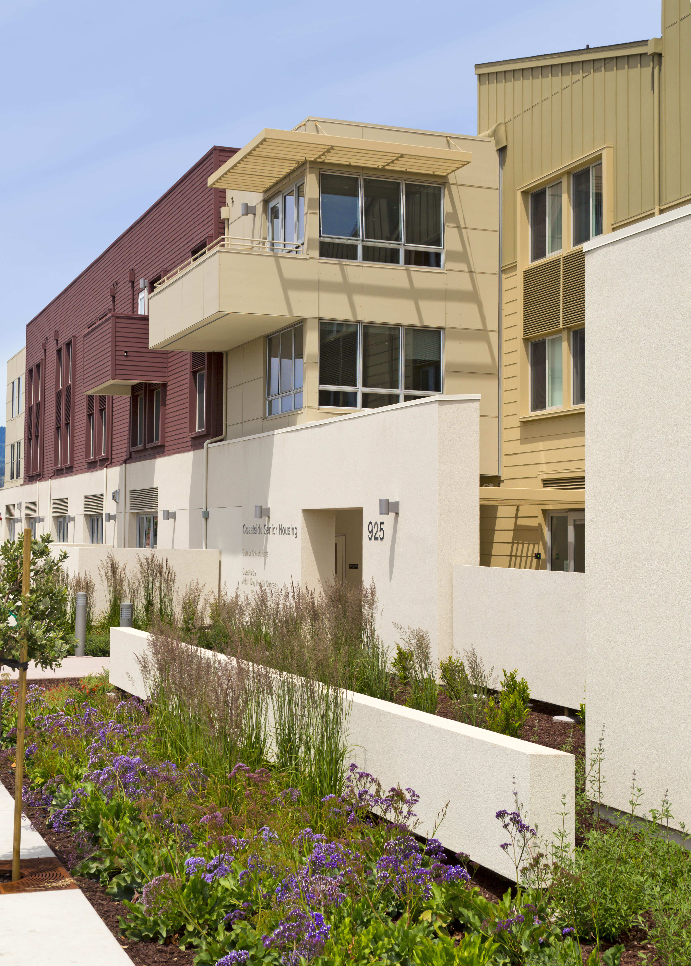
Homelessness/Housing
Emergency housing assistance for 382 households with 66% remaining housed
762 families housed through Motel Voucher Program with 67% exiting to transitional housing
Homeless Outreach Teams engaged 156 individuals with 24 or 15.4% transitioning to permanent housing
40 shelter beds operating year-round in East Palo Alto

Slide 11
Parks
Completed 34 projects on time and on-budget
7 Parks positions funded
Maintenance equipment purchased
Two automated pay stations installed at Coyote Point Recreation Area

Slide 12
Transportation – Paratransit Services
Zero trip denials for Redi-Wheels service
90% on-time performance
291,802 annual Redi-Wheels ridership, up 5.4% from last year

Slide 13
Technology Infrastructure
11 WiFi sites completed
429 network ports upgraded for faster speed
Open Data Platform accessed 3,772,160 times

Slide 14
Capital Improvements in progress
Public Safety 911/ Emergency Operations and Data Center
Pescadero Fire Station
Cordilleras Mental Health Facility
Library improvements
South San Francisco
Daly City
Half Moon Bay
East Palo Alto
North Fair Oaks
Pacifica

Slide 15
What’s Ahead
Measure A logo to highlight projects in the community
Website and dashboard re-design
Next meeting of Oversight Committee: September 29, 2016

Slide 16
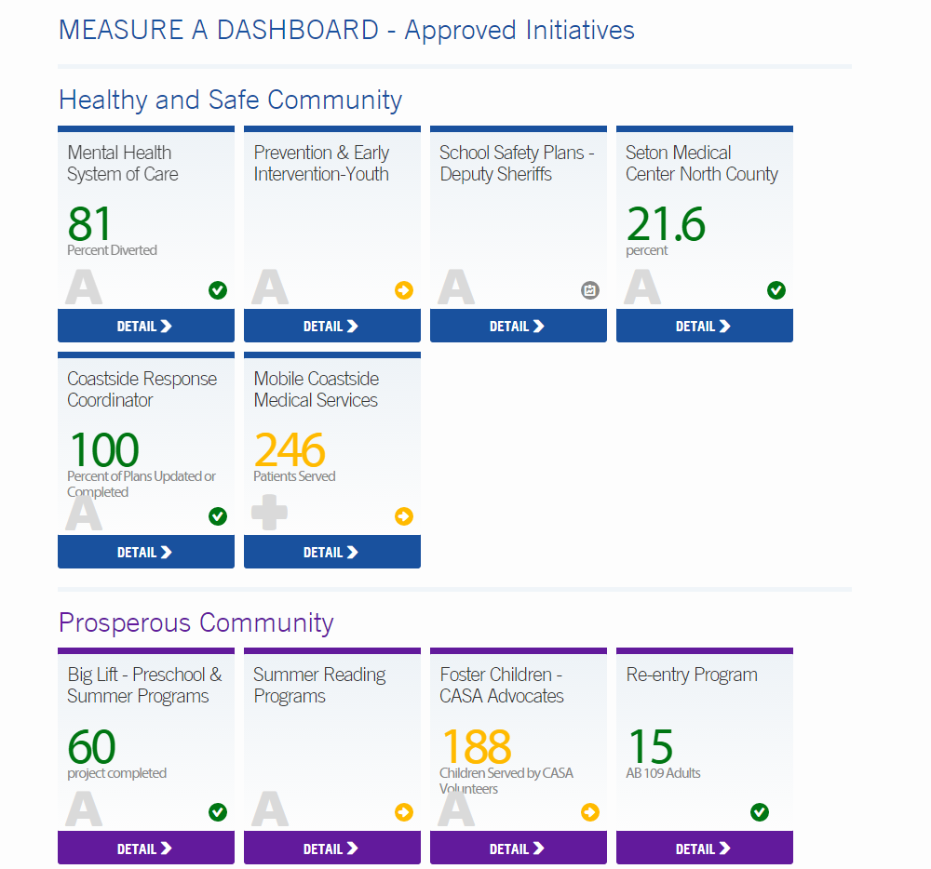
Measure A Dashboard https://performance.smcgov.org/measure-a
Notes:
16

Slide 17
Thank You

